Slide 1

Data-Driven Investing Optimizing Investment Returns by Analyzing Historical Stock Data
Presented by Dan Wilde
Nov 2, 2021

Slide 2
Background and Scope
Create a data solution whereby investors can test the returns on a theoretical portfolio of stocks over a given timeframe using actual historical stock price data
The solution will serve as a tool for determining where and when to invest
Focus mainly on dividend-paying stocks (from S&P 500)
1 or 2 macroeconomic data sets to further enhance the analysis
Financial data from the past 20 to 40 years will be gathered and used

Slide 3
You can have data without information, but you cannot have information without data
-Daniel Keys Moran
Computer Programmer and Science Fiction Writer

Slide 4
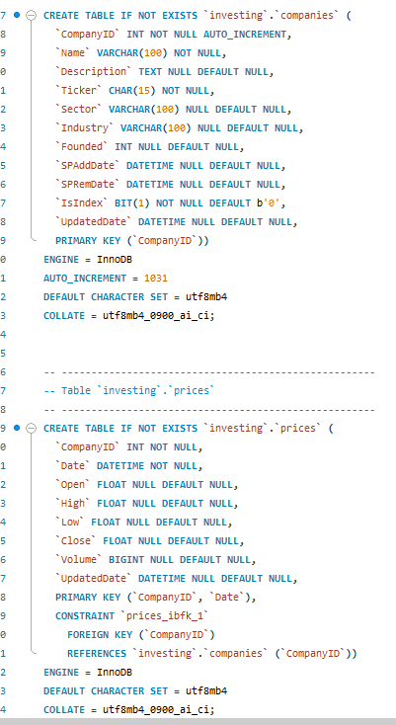
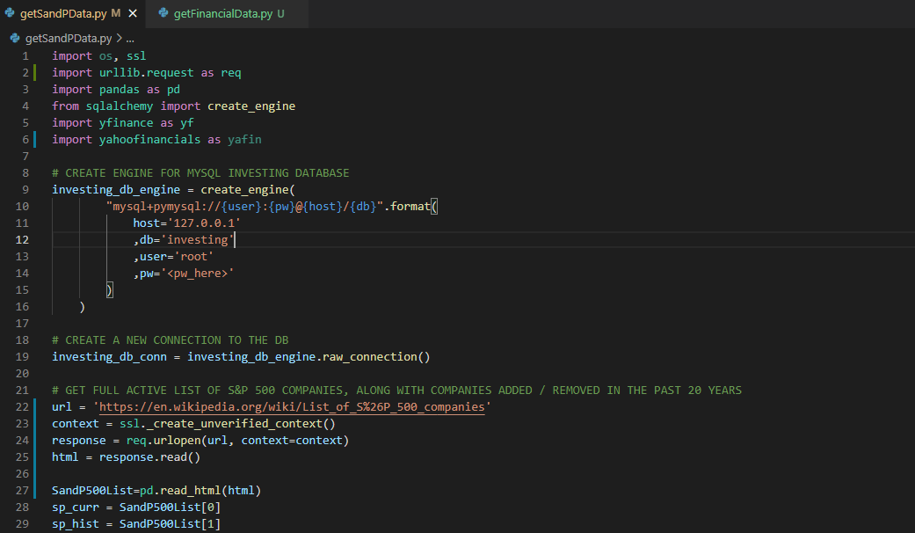
Data Collection Strategy
2 TABLES:
Companies
Prices
1 Python Script:
getSandPData.py

Slide 5
Designing Database Solutions
Considerations, Methodology, and Implementation

Slide 6
THANKS!
ANY QUESTIONS?
You can reach me at:
Email: daniel.r.wilde@gmail.com
LinkedIn: https://www.linkedin.com/in/dan-wilde-sandiego-/

Slide 7
CREDITS
Special thanks to all the people who made and released these awesome resources for free:
Presentation template by SlidesCarnival
Photographs by Unsplash

